Slide 1


http://redux.js.org
https://githubcom/rackt/redux
http://courses.reactjsprogram.com/courses/reactjsfundamentals

Slide 2
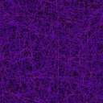
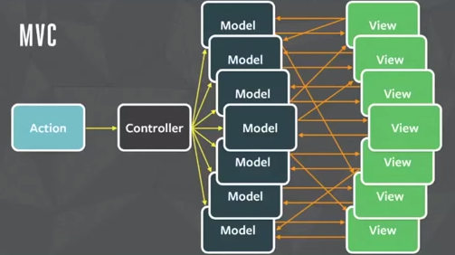
MVC
The problem with this is when there are many views and models and one of the model’s state changed into something we didn’t expect, we are unable to efficiently trace which view or which model caused the problem.

Slide 3
Redux
Flux/Redux makes debugging apps easier by removing the model setter, and then letting the store update its own state via an action (which is the “unidirection data flow”)
The dispatch of an action cannot dispatch another action.
This way, a store will be actively updated as opposed to passively updated, and whenever there is a bug, we can refer to the problematic store to see what events have happened before.
This makes debugging easy.

Slide 4
Redux
Redux is a predictable state container for JavaScript apps.
Redux is a tiny library (2KB API) that acts as a container for application state, by combining ideas from Flux and Elm.
A simple, predictable state model. An emphasis on functional programming and immutable data.
Redux is a framework that extends the ideas of Flux and simplifies redundant things.
Flux/Redux attempts to resolve the problem where bugs are difficult to trace when a model has been continuously updated as an app is being used.

Slide 5
Redux
It helps to write applications that behave consistently, run in different environments (client, server), and are easy to test.
Provides a great developer experience, such as live code editing combined with a time traveling debugger.
Use Redux together with React, or with any other view library.
Use Redux to manage any kind of application state with following guidelines:
State is kept in a single store
Changes come from actions not mutations

Slide 6
Redux
All kinds of frameworks and architectures have state.
In Ember apps and Backbone apps, state is in Models.
In Angular apps, state is often in Factories and Services.
In most Flux , it is in Stores.
In Redux, the application state is all stored in one single tree structure called immutable state tree.
Application's state is stored in one data structure formed out of maps and arrays.
The state is pure data. It doesn't have methods or functions. And it isn't tucked away inside objects. It's all in one place.

Slide 7
Redux
Single State tree
State is read-only
Reducers are pure functions
Reducer update state
(state, action (type,data))=> new state
Use immutable js to return state with map/list…

Slide 8
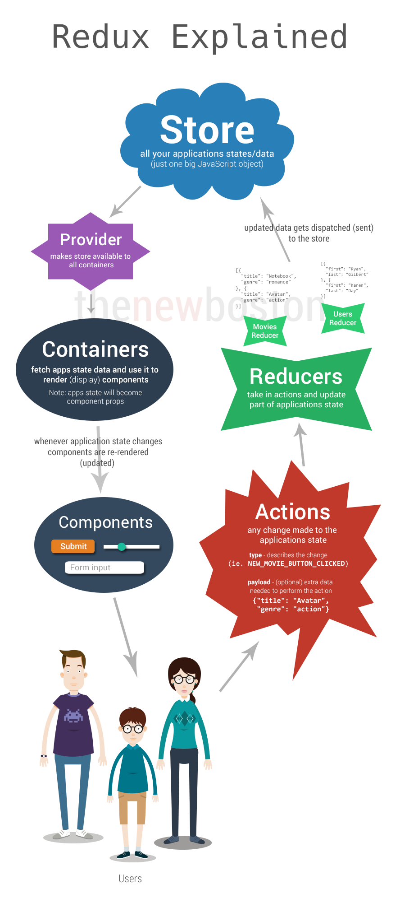

Slide 9
Redux
store: manages the states. All our application data and state resides here . (Like brain for app). In a Redux app, you can obtain its states via store.getState()
Provider makes all store available to containers (react-redux provider)
Containers : fetch app state data and use it to render components. (it is like a glue to connecct connect store to component. (connect). Whenever app state changes, component re-renders to keep state in sync with UI
App state becomes component props in React.

Slide 10
Redux
Component: UI widget of react component to display state from store.
action: A plain JavaScript object. Any changes made to application state (event handling). An action can also be considered as a command to change a state.
reducer: decides how to change a state after receiving an action, and thus can be considered the entrance of a state change. (we can have multiple reducers eg. MovieReducer, UserReducer… in youtube.com)
Take an action and update part of application state.

Slide 11
Redux
A reducer is comprised of functions, and it changes states by taking an action as an argument, in which it then returns a new state.
middleware:
The middleman between store.dispatch() and a reducer.
Its purpose is to intercept an action that has been dispatched, and modify or even cancel the action before it reaches the reducer.

Slide 12
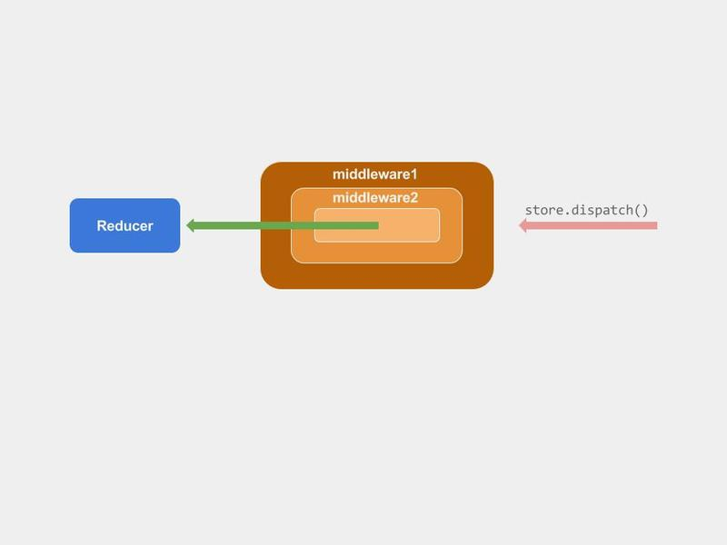
Redux

Slide 13
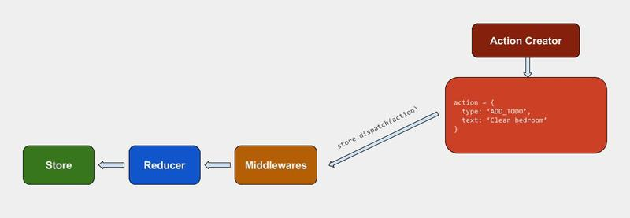
Redux

Slide 14
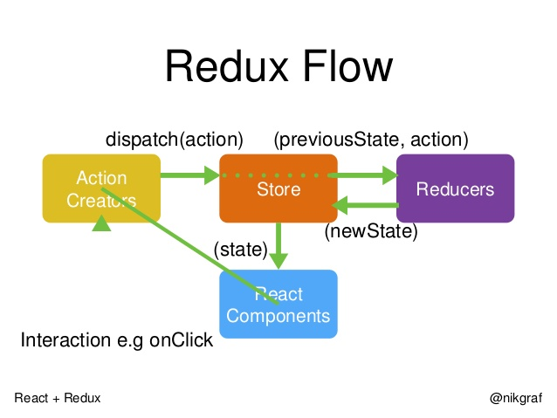
Redux

Slide 15
Redux
A Redux application's state tree is an immutable data structure.
Once state tree is created, it will never change as long as it exists.
It will keep holding the same state forever.
Go to the next state is by producing another state tree that reflects the changes we wanted to make.
This means any two successive states of the application are stored in two separate and independent trees.
To go to the next state apply a function that takes the current state and returns a new state.

Slide 16
Redux
Benefit of single tree:
Hold on to the history of application state without doing much extra work
Just keep a collection of the previous state trees around.
Do things like undo/redo for "free" - just set the current application state to the previous or next tree in the history.
Serialize the history and save it for later, or send it to some storage so that to repay later, which can be hugely helpful when debugging.

Slide 17
Redux
To Install redux :
>npm install --save redux
Complementary Packages
React bindings and the developer tools.
>npm install --save react-redux
>npm install --save-dev redux-devtools
>npm install - - save redux-logger
>npm install - - save redux-thunk
>npm install - -save redux-axios

Slide 18
Redux
Redux attempts to make state mutations predictable by imposing certain restrictions on how and when updates can happen.
These restrictions are reflected in the three principles of Redux.
Single Source of Truth
The state of whole application is stored in an object tree within a single store. (In Flux , multi store)
So faster development lifecycle
Easy to debug

Slide 19
Redux
2. State is read-only
- The only way to change the state is to emit an action, an object describing what happened.
(actions are just plain objects, they can be logged, serialized, stored, and later replayed for debugging or testing purposes)
store.dispatch({
type: 'COMPLETE_TODO',
index: 1
})

Slide 20
Redux
3. Changes are made with pure functions
To specify how the state tree is transformed by actions- write pure reducers.
Reducers are just pure functions that take the previous state and an action, and return the next state.
We can have multiple reducers (Combined Reducer)

Slide 21
Flux vs Redux
Redux was inspired by several important qualities of Flux.
“stores” in Flux, “reducers” in Redux)
Instead of letting the application code directly mutate the data, both tell you to describe every mutation as a plain object called an “action”.
Redux does not have the concept of a Dispatcher
Redux assumes you never mutate your data.
Redux always return a new object, which is easy with the object spread operator proposal (Object.assign ,filter,concat,map) , or with a library like Immutable.
Time travel debugging, undo/redo

Slide 22
Redux - Actions
Actions are payloads of information that send data from application to store using store.dispatch();
They are the only source of information for the store.
Here's an example action which represents adding a new todo item:
Actions are plain JavaScript objects.
Actions must have a type property that indicates the type of action being performed.
Types should be defined as string constants.
import { ADD_TODO, REMOVE_TODO } from '../actionTypes‘ (actions moved to separate modules)
{ type: TOGGLE_TODO, index: 5 }

Slide 23
Redux - Actions
Action Creators
Action creators are exactly that—functions that create actions.
In Redux action creators simply return an action:
function addTodo(text) {
return {
type: ADD_TODO,
text:’’
}
}
This makes them portable and easy to test.

Slide 24
Redux - Actions
create a bound action creator that automatically dispatches:
const boundAddTodo =
(text) => dispatch(addTodo(text))
Now you'll be able to call them directly:
boundAddTodo(text)

Slide 25
Redux - Reducer
Actions describe the fact that something happened, but don't specify how the application's state changes in response. This is the job of a reducer.
At the core of a Redux store is a function that takes the current application state and an action and combines them to create a new application state.
This function is called reducer.
Simple Reducer
CombinedReducers
Splitting reducers and loading from modules

Slide 26
Redux - Store
actions represent the facts about “what happened” and reducers update the state according to those actions.
The Store is the object that brings them together.
The store has the following responsibilities:
Holds application state;
Allows access to state via getState();
Allows state to be updated via dispatch(action);
Registers listeners via subscribe(listener);
Handles unregistering of listeners via the function returned by subscribe(listener).
only have a single store in a Redux application.
To split data handling logic, use reducer composition instead of many stores.

Slide 27
Redux – Data Flow
Redux architecture revolves around a strict unidirectional data flow.
All the data in an application follows the same lifecycle pattern, making the logic of app more predictable and easier to understand.
Redux has no relation to React. You can write Redux apps with React, Angular, Ember, jQuery, or vanilla JavaScript.
Installing React Redux
React bindings are not included in Redux by default.
npm install --save react-redux

Slide 28
Redux- Designing application Tree
Designing a Redux app begins by thinking about the application state data structure to know application at any given time.
All kinds of frameworks and architectures have state. In Ember apps and Backbone apps, state is in Models. In Angular apps, state is often in Factories and Services. In most Flux implementations, it is in Stores.
In Redux, the application state is all stored in one single tree structure and everything there is to know about application's state is stored in one data structure formed out of maps and arrays.

Slide 29
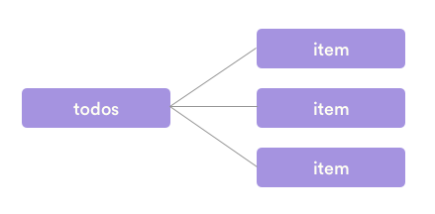
Redux
The whole state of the app is contained in a single data structure, the state tree. So what is displayed at every moment to the user is only consequence of what is inside the state tree, which is the single source of truth.
Every action in app takes the state tree, apply the corresponding modifications (add a todo, for example) and outputs the updated state tree, which is then rendered to the user.
There is no obscure side effects, no more references to a variable that was inadvertantly modified and cleaner separation of concerns, a better app structure and allows for much better debugging.

Slide 30
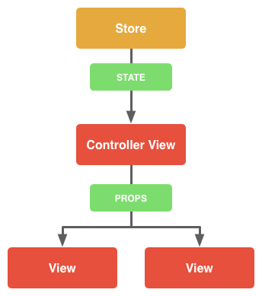
React vs Redux

Slide 31
ImmutableJS
Because Redux doesn’t allow to mutate the application state, it can be helpful to enforce this by modeling application state with immutable data structures.
ImmutableJS offers us a number of immutable data structures with mutative interfaces and they’re implemented in an efficient way, inspired by the implementations in Clojure and Scala.

Slide 32
ImmutableJS
Immutable is a helper library developed by Facebook that provides tools to create and manipulate immutable data structures.
With Immutable, to update an object, create another one with the modifications, and leave the original one as is.
Documentation:
https://facebook.github.io/immutable-js/

Slide 33
ImmutableJS
Var Immutable=require(‘immutable’);
var map1 = Immutable.Map({a:1, b:2, c:3});
var map2 = map1.set('b', 2);
assert(map1 === map2); // no change
var map3 = map1.set('b', 50);
assert(map1 !== map3); // change

Slide 34
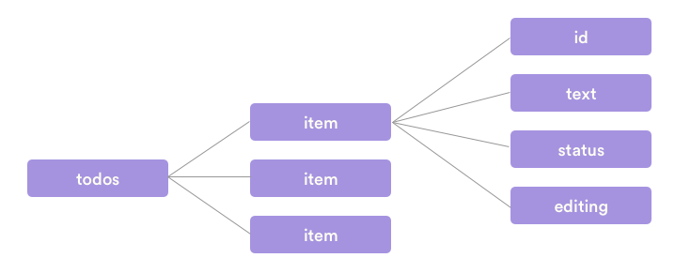
Todo App – State Tree

Slide 35
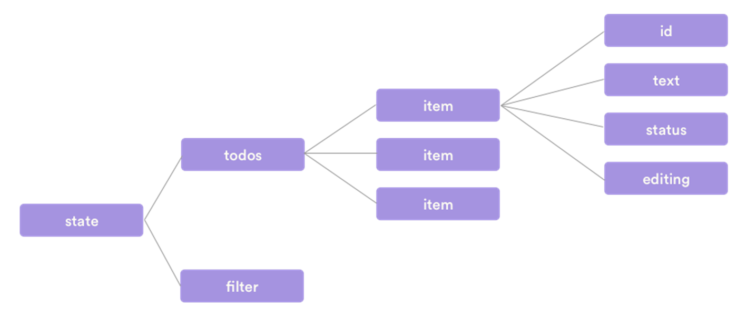
Todo App – State Tree with filter

Slide 36
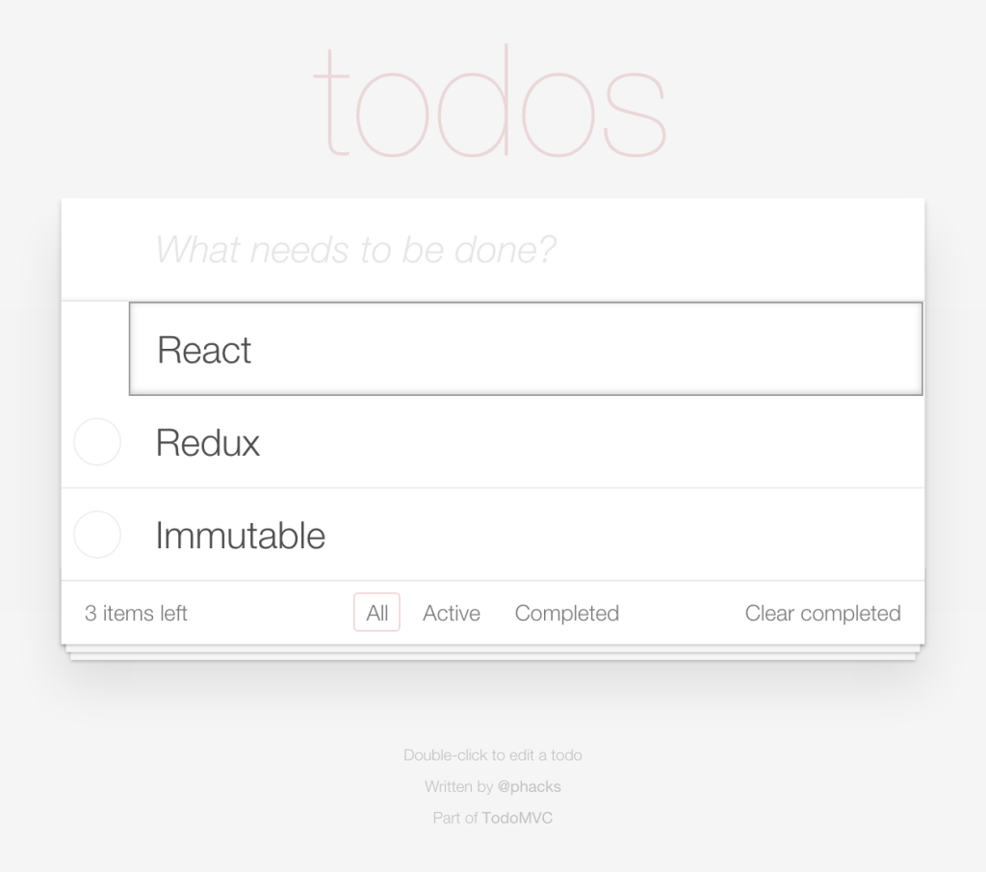
Todo App – State Tree with filter

Slide 37
Redux – Testing with mocha/chai
import {expect} from 'chai';
describe('immutability', () => {
describe('a number', () => {
function increment(currentState) {
return currentState + 1;
}
it('is immutable', () => {
let state = 42;
let nextState = increment(state);
expect(nextState).to.equal(43);
expect(state).to.equal(42);
});
});
}); state doesn't change when increment is called as Numbers are immutable!

Slide 38
Redux – Testing with mocha/chai
import {expect} from 'chai';
import {List} from 'immutable';
describe('immutability', () => { // Immutable List function
describe('A List', () => {
function addMovie(currentState, movie) {
return currentState.push(movie);
}
it('is immutable', () => {
let state = List.of(‘Leader', ‘Kabali');
let nextState = addMovie(state, ‘Okkadu');
expect(nextState).to.equal(List.of(
‘Leader', ‘Kabali', ‘Okkadu'
));
expect(state).to.equal(List.of(‘Leader', ‘kabali' ));
});
});

Slide 39
Redux – Testing with mocha/chai
import {expect} from 'chai';
import {List, Map} from 'immutable';
describe('immutability', () => { // Immutable map()
describe('a tree', () => {
function addMovie(currentState, movie) {
return currentState.set( 'movies',
currentState.get('movies').push(movie)
);
}
it('is immutable', () => {
let state = Map({
movies: List.of(‘Leader', ‘Kabali')
});

Slide 40
Redux – Testing with mocha/chai
let nextState = addMovie(state, 'Sunshine');
expect(nextState).to.equal(Map({
movies: List.of(‘Leader', ‘Kabali',‘Okkadu'
)
}));
expect(state).to.equal(Map({
movies: List.of( ' Leader ', Kabali '
)
}));

